Slide 1
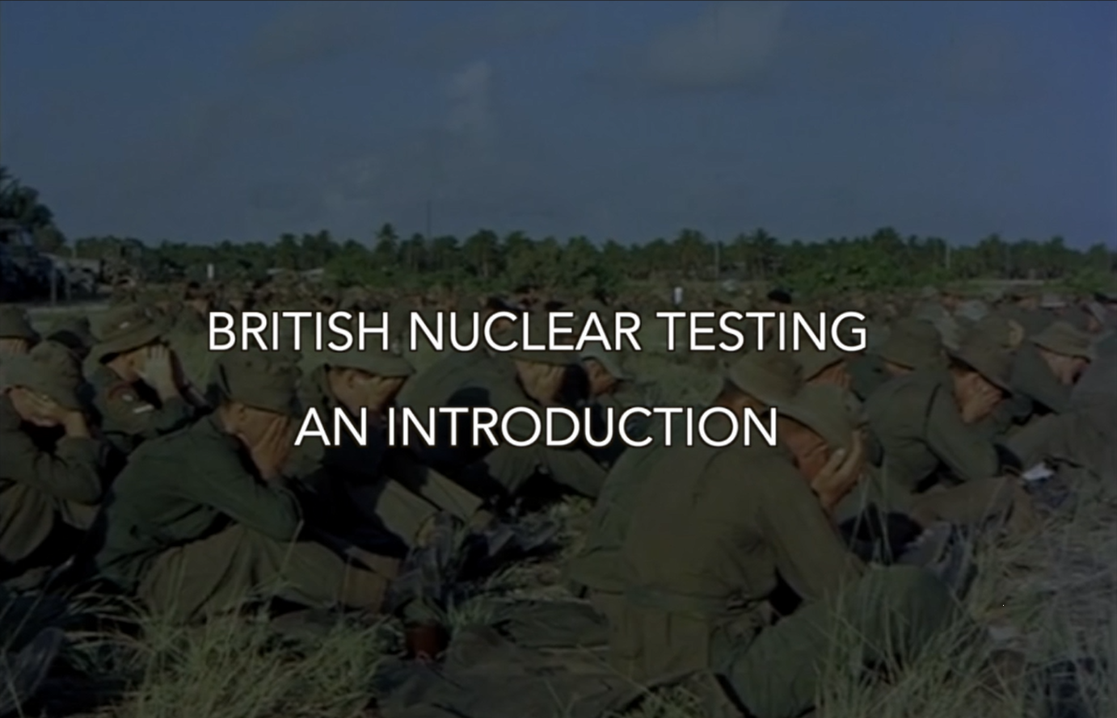

Slide 2
Welcome to the Supplementary guide for
BRITISH NUCLEAR TESTING
AN INTRODUCTION
‘Have You Seen The Dragon’
All material is provided on a free to use license for education purposes only.
The Intellectual property Rights to this material and the video are the property of LABRATS CIC. (Company no 12874772 registered in the UK)
No unauthorised copying or distribution other than for education purposes across the world.

Slide 3
BRITISH NUCLEAR TESTING
AN INTRODUCTION
‘Have You Seen The Dragon’
The educational video is available on the LABRATS YouTube channel by clicking the link below:
www.labratsacademy.online/ukeducation
This video lasts 18 minutes and contains details and information about the British Nuclear testing program (both atmospheric and underground) as well as clean-up operations.

Slide 4
BRITISH NUCLEAR TESTING
AN INTRODUCTION
‘Have You Seen The Dragon’
Each testing operation was given a code name by the British Government. The following slides detail the codename for the Operations. Each slide will show:
Year(s)
Number of Tests
Location
Approximate Total Yield (given in kilotons)

Slide 5
BRITISH NUCLEAR TESTING
AN INTRODUCTION
‘Have You Seen The Dragon’
Instructor Notes:
The video contains each of the test slides, but they are provided here for reference purposes and to show the location using Google Earth for reference.
The testing program ran from 1952-1991.
The UK tested in Australia, Pacific Islands and the Nevada Desert (USA)
Further information about worldwide testing can be found at www.labratsacademy.online
Further information about the participants of the tests can be found at https://damned.mirror.co.uk/

Slide 7
BRITISH NUCLEAR TESTING
AN INTRODUCTION
‘Have You Seen The Dragon’
Diary Information
The LABRATS Academy contains a calendar of tests, each day is listed with the details of the country and testing undertaken.
The calendar will show just how much testing has been undertaken across the world as well as provide information for a particular day.
You can access this resource using the following link:
https://www.labratsacademy.online/diary

Slide 9
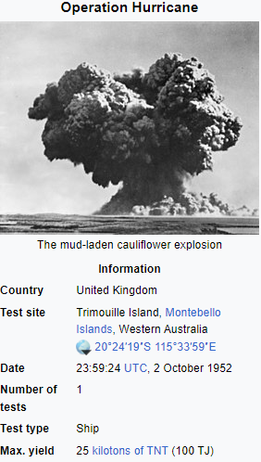
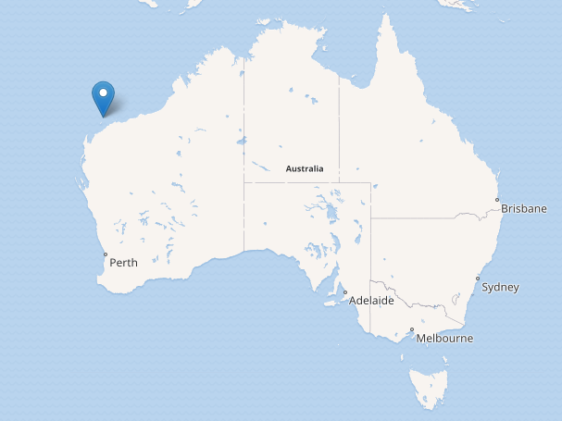
Operation Hurricane

Slide 11
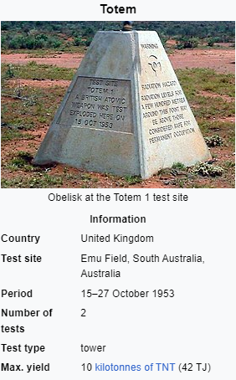
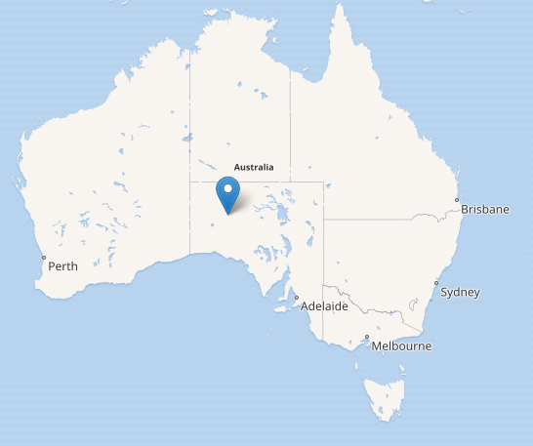
Operation Totem

Slide 13
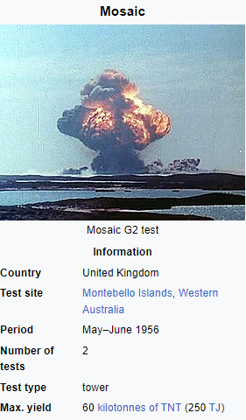
Operation Mosaic

Slide 15
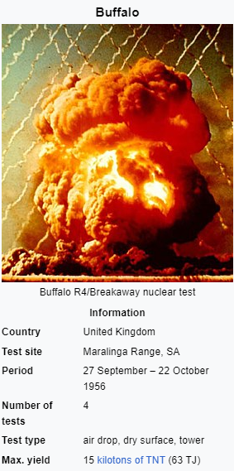
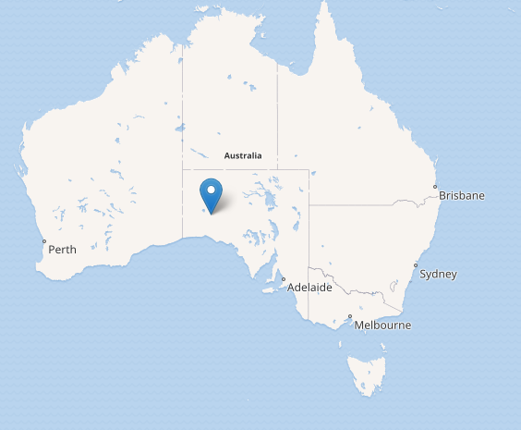
Operation Buffalo

Slide 17
Operation Antler

Slide 19
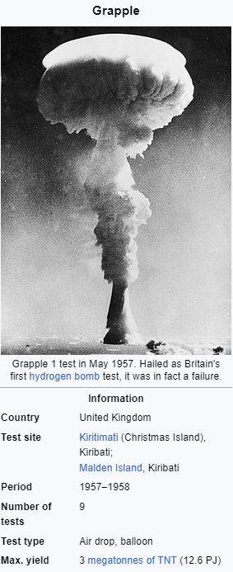
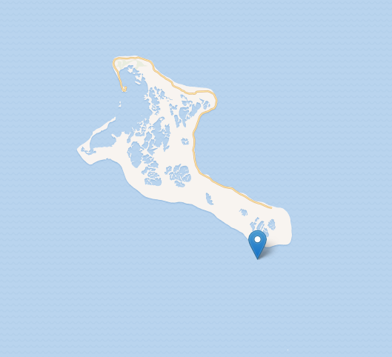
Operation Grapple

Slide 21
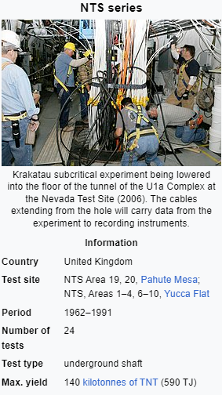
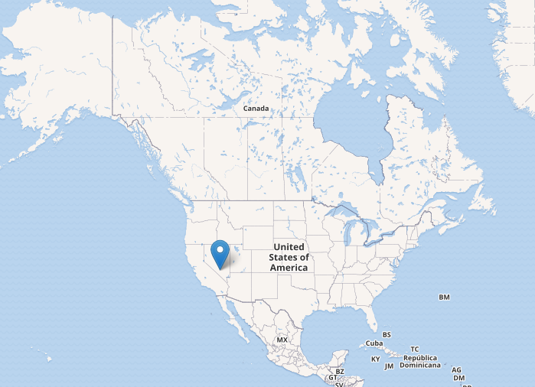
NTS Series

Slide 23
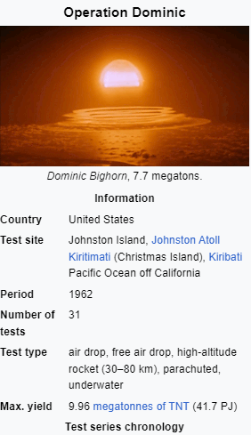
Operation Dominic

Slide 25
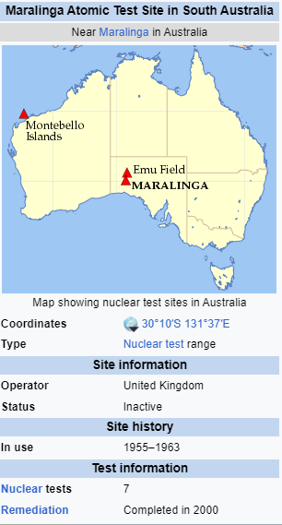
Minor Trials

Slide 27
Cleanup Operations

Slide 28
BRITISH NUCLEAR TESTING
AN INTRODUCTION
‘Have You Seen The Dragon’
Please provide feedback on the Video and the Educational Material provided by emailing info@labrats.international.
Your feedback is very important to us to improve our services.
If you haven’t already, take the educational Quizes available on the Academy website and share the experience with your students.
A full teacher companion pack for the quizzes can be found at:
https://www.labratsacademy.online/teacher

